Slide 1
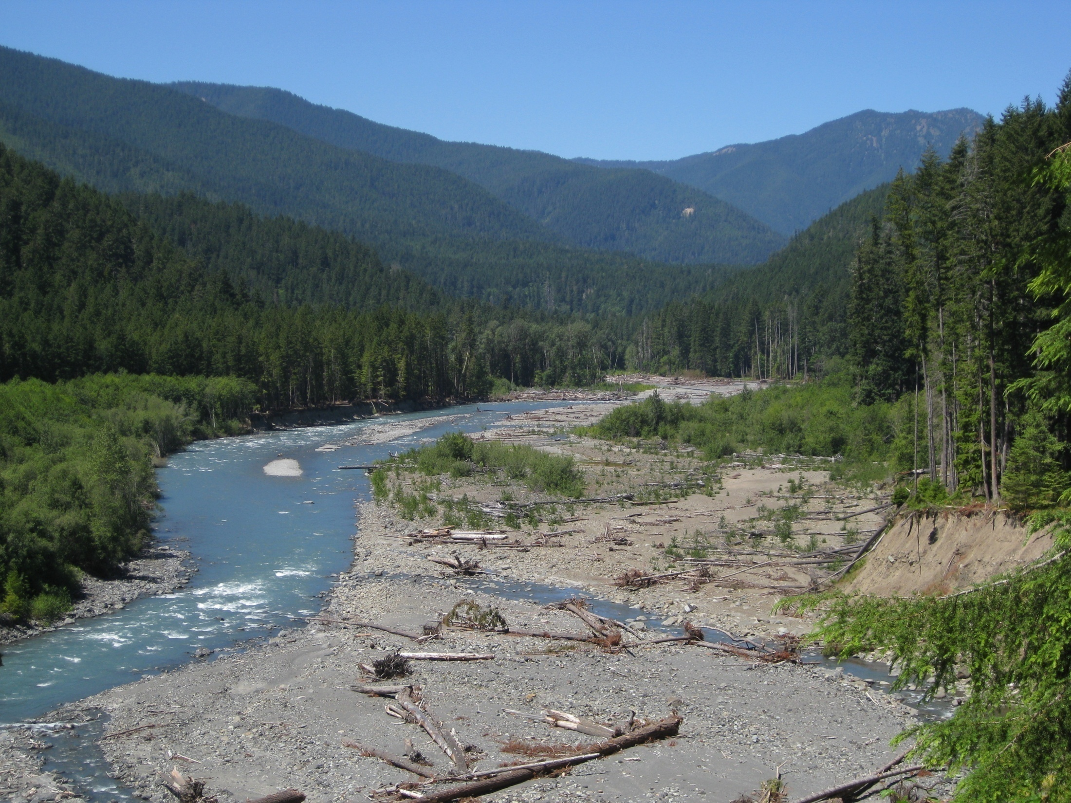
The Elwha River
Modeling Changes in the River’s Course as the Glines Canyon Dam is Removed and Lake Mills Drains.

Slide 2
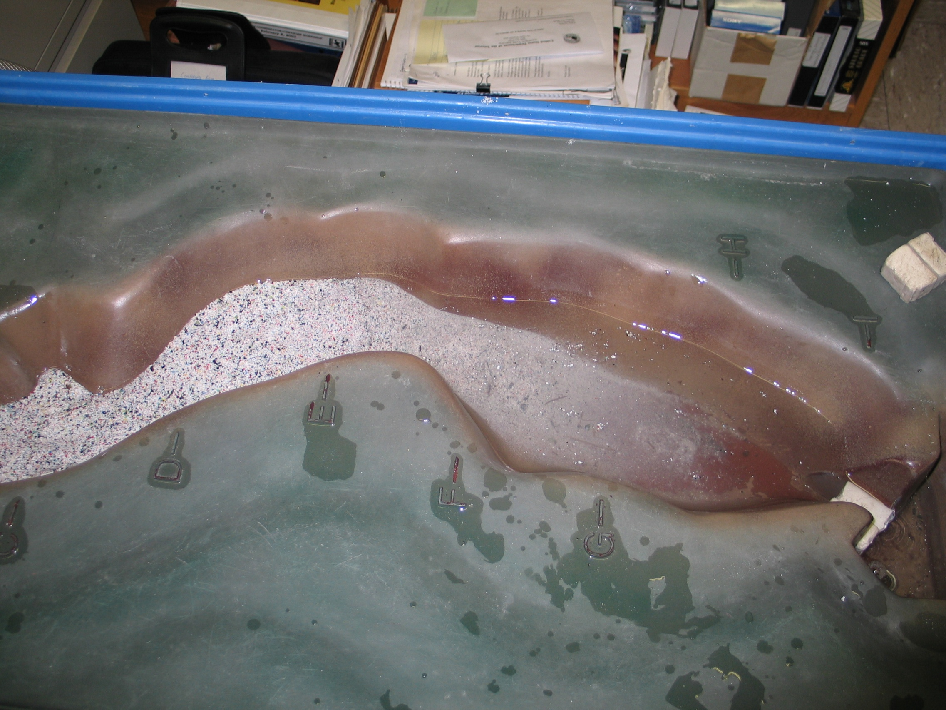
The Former Lake Level is the Blue Area
The New Lake Level is the Line Below

Slide 3

The Former Lake Level is the Blue Line
The Delta Forms Where the River Meets the Lake

Slide 4
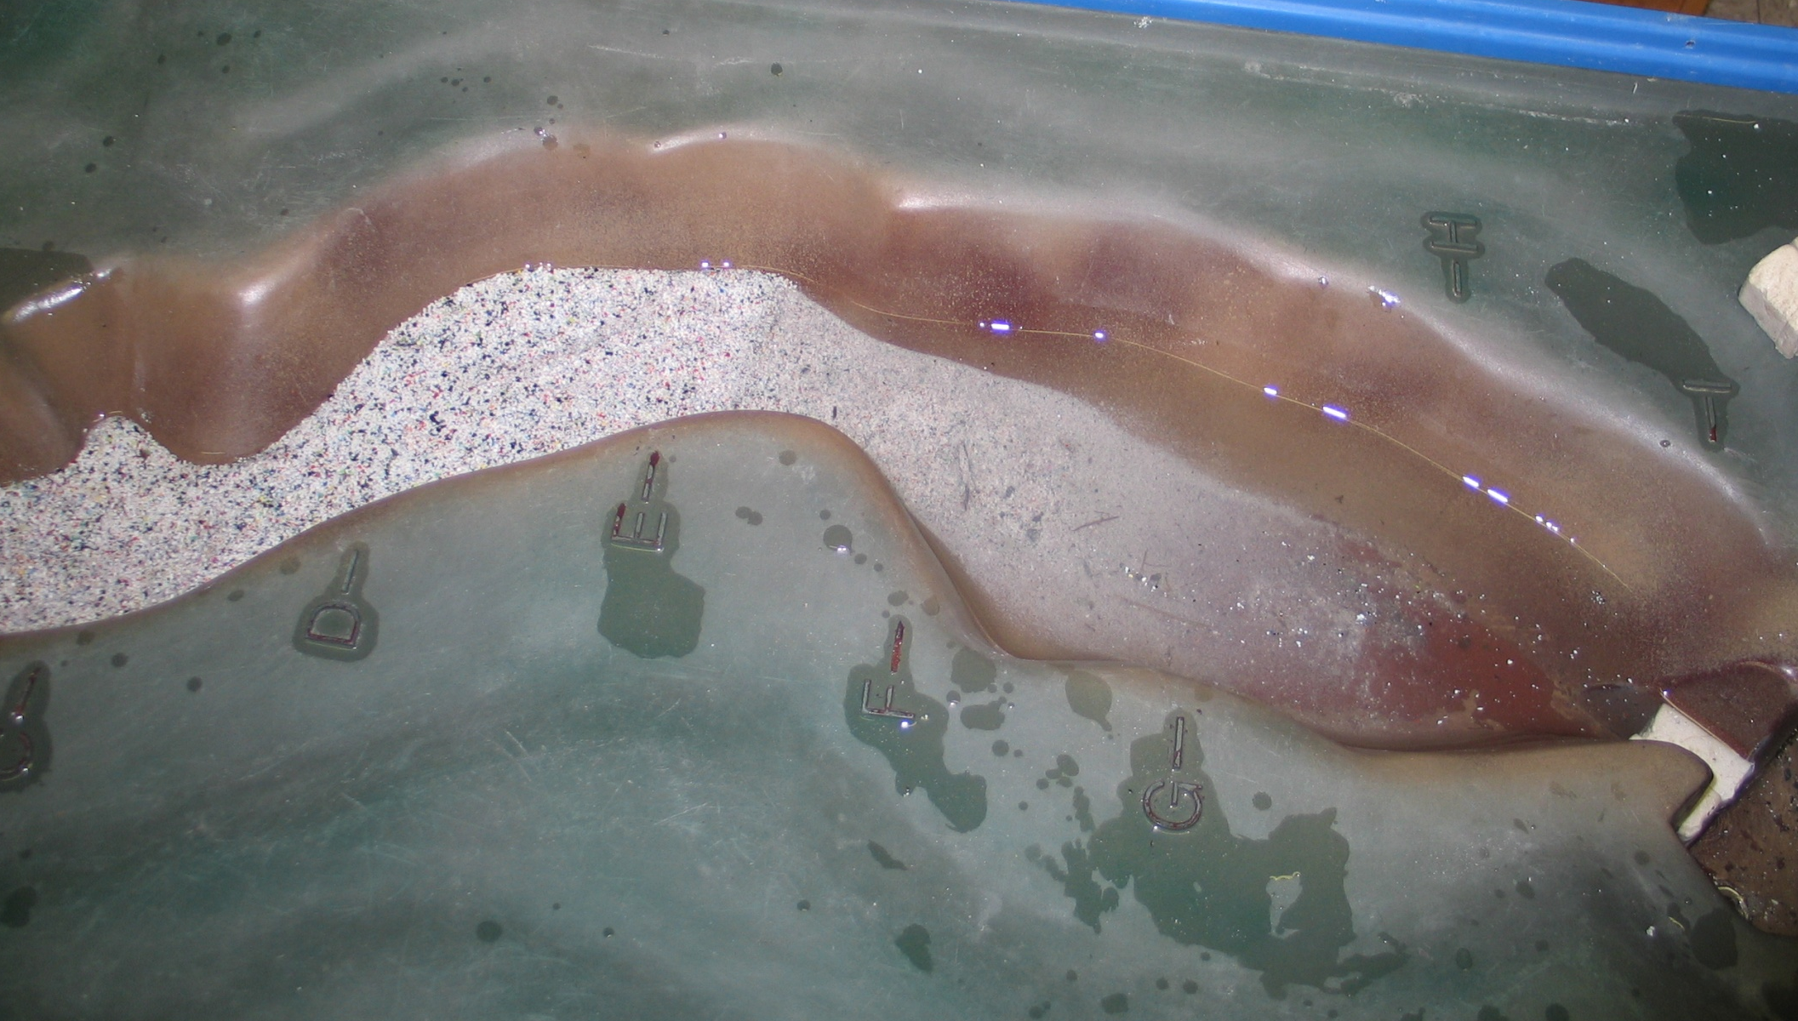

Slide 5
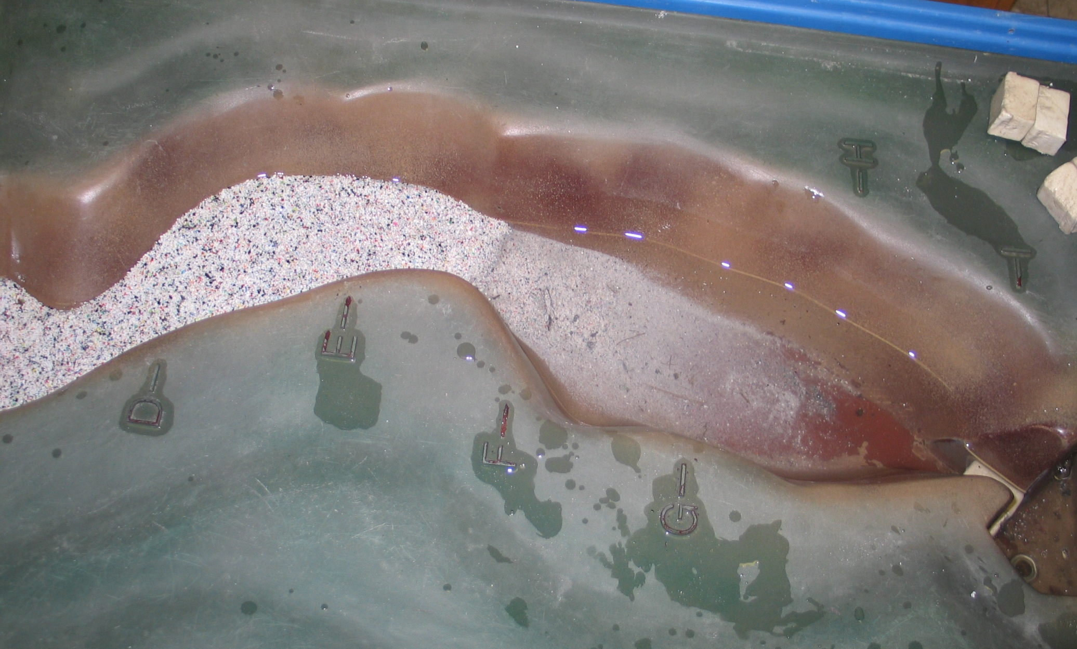
One Segment of the Dam Remains
So, the Lake Level Remains Stable Until it is Removed

Slide 6
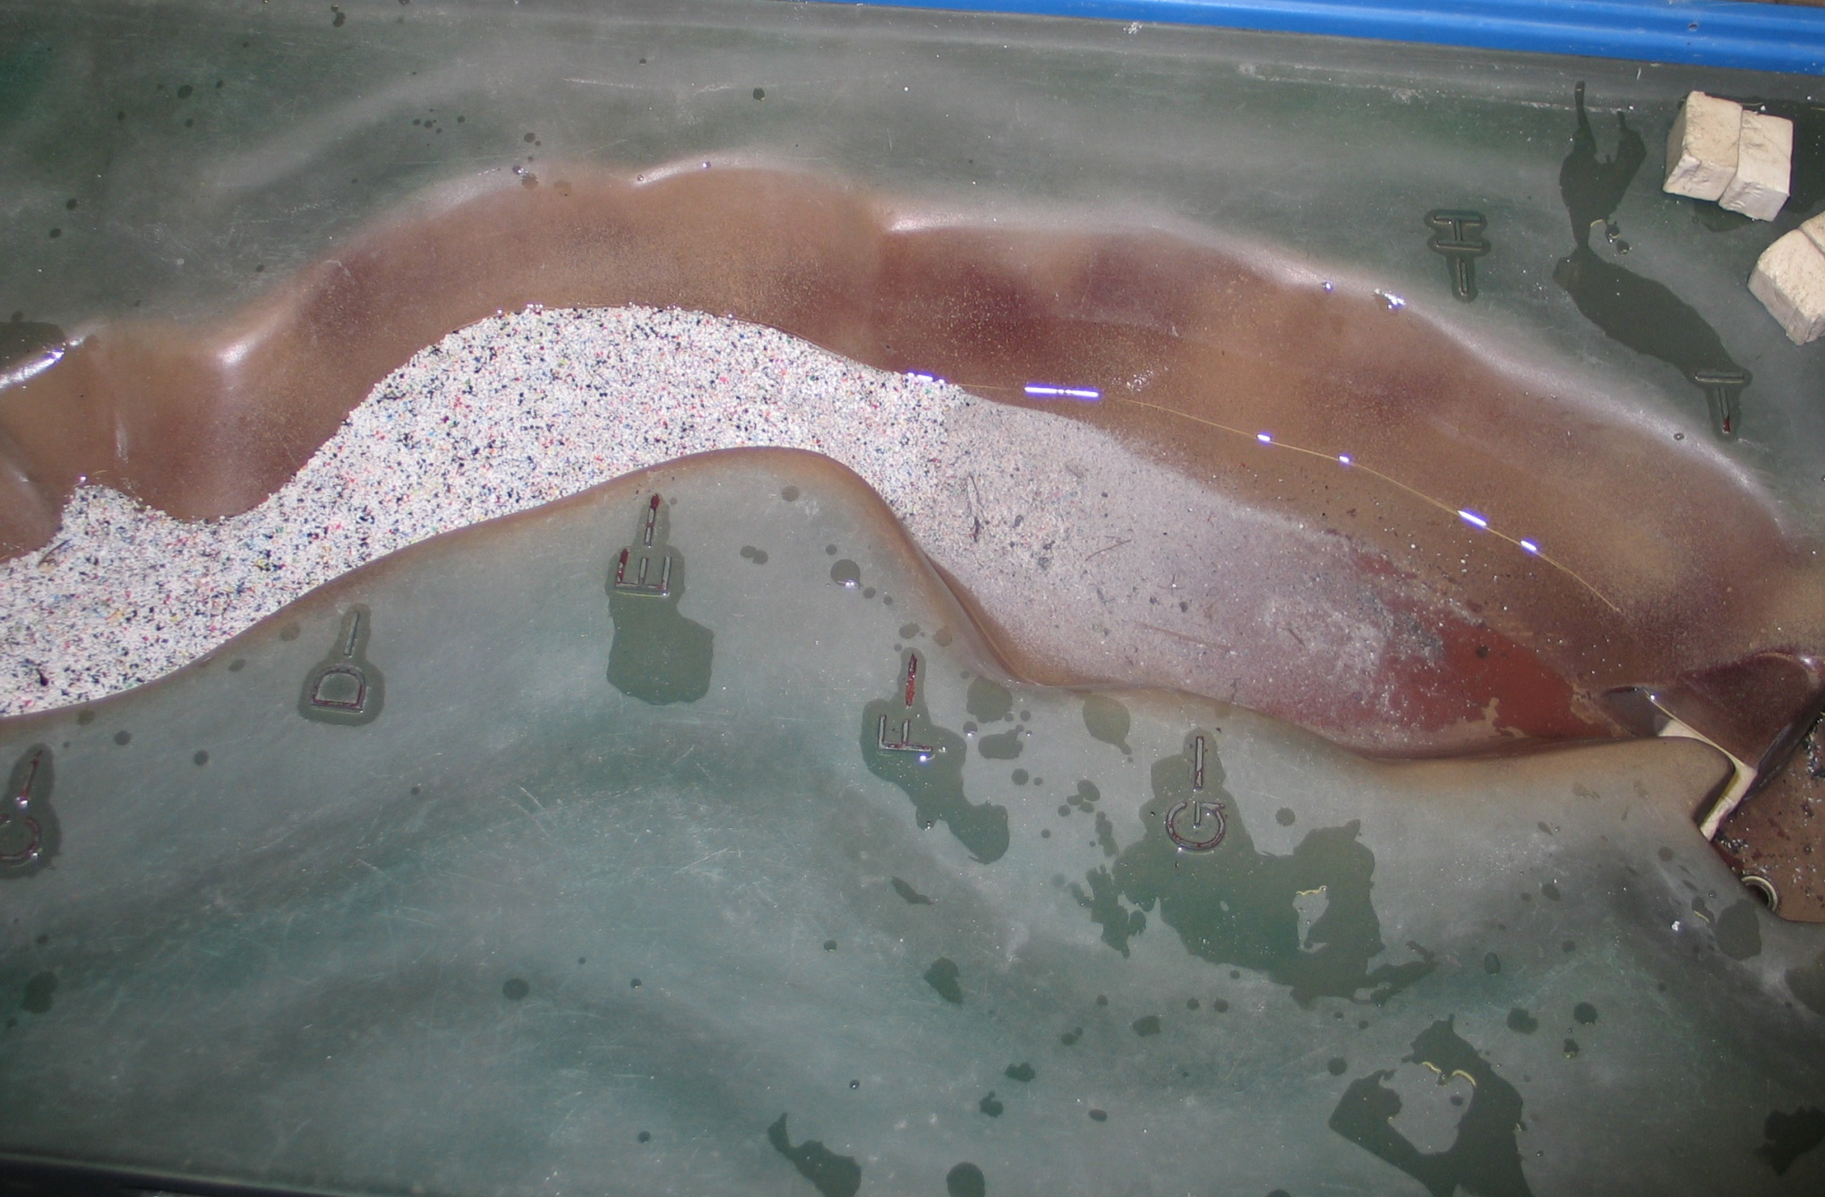
The Ring of the Former Lake Level is Still Visible

Slide 7
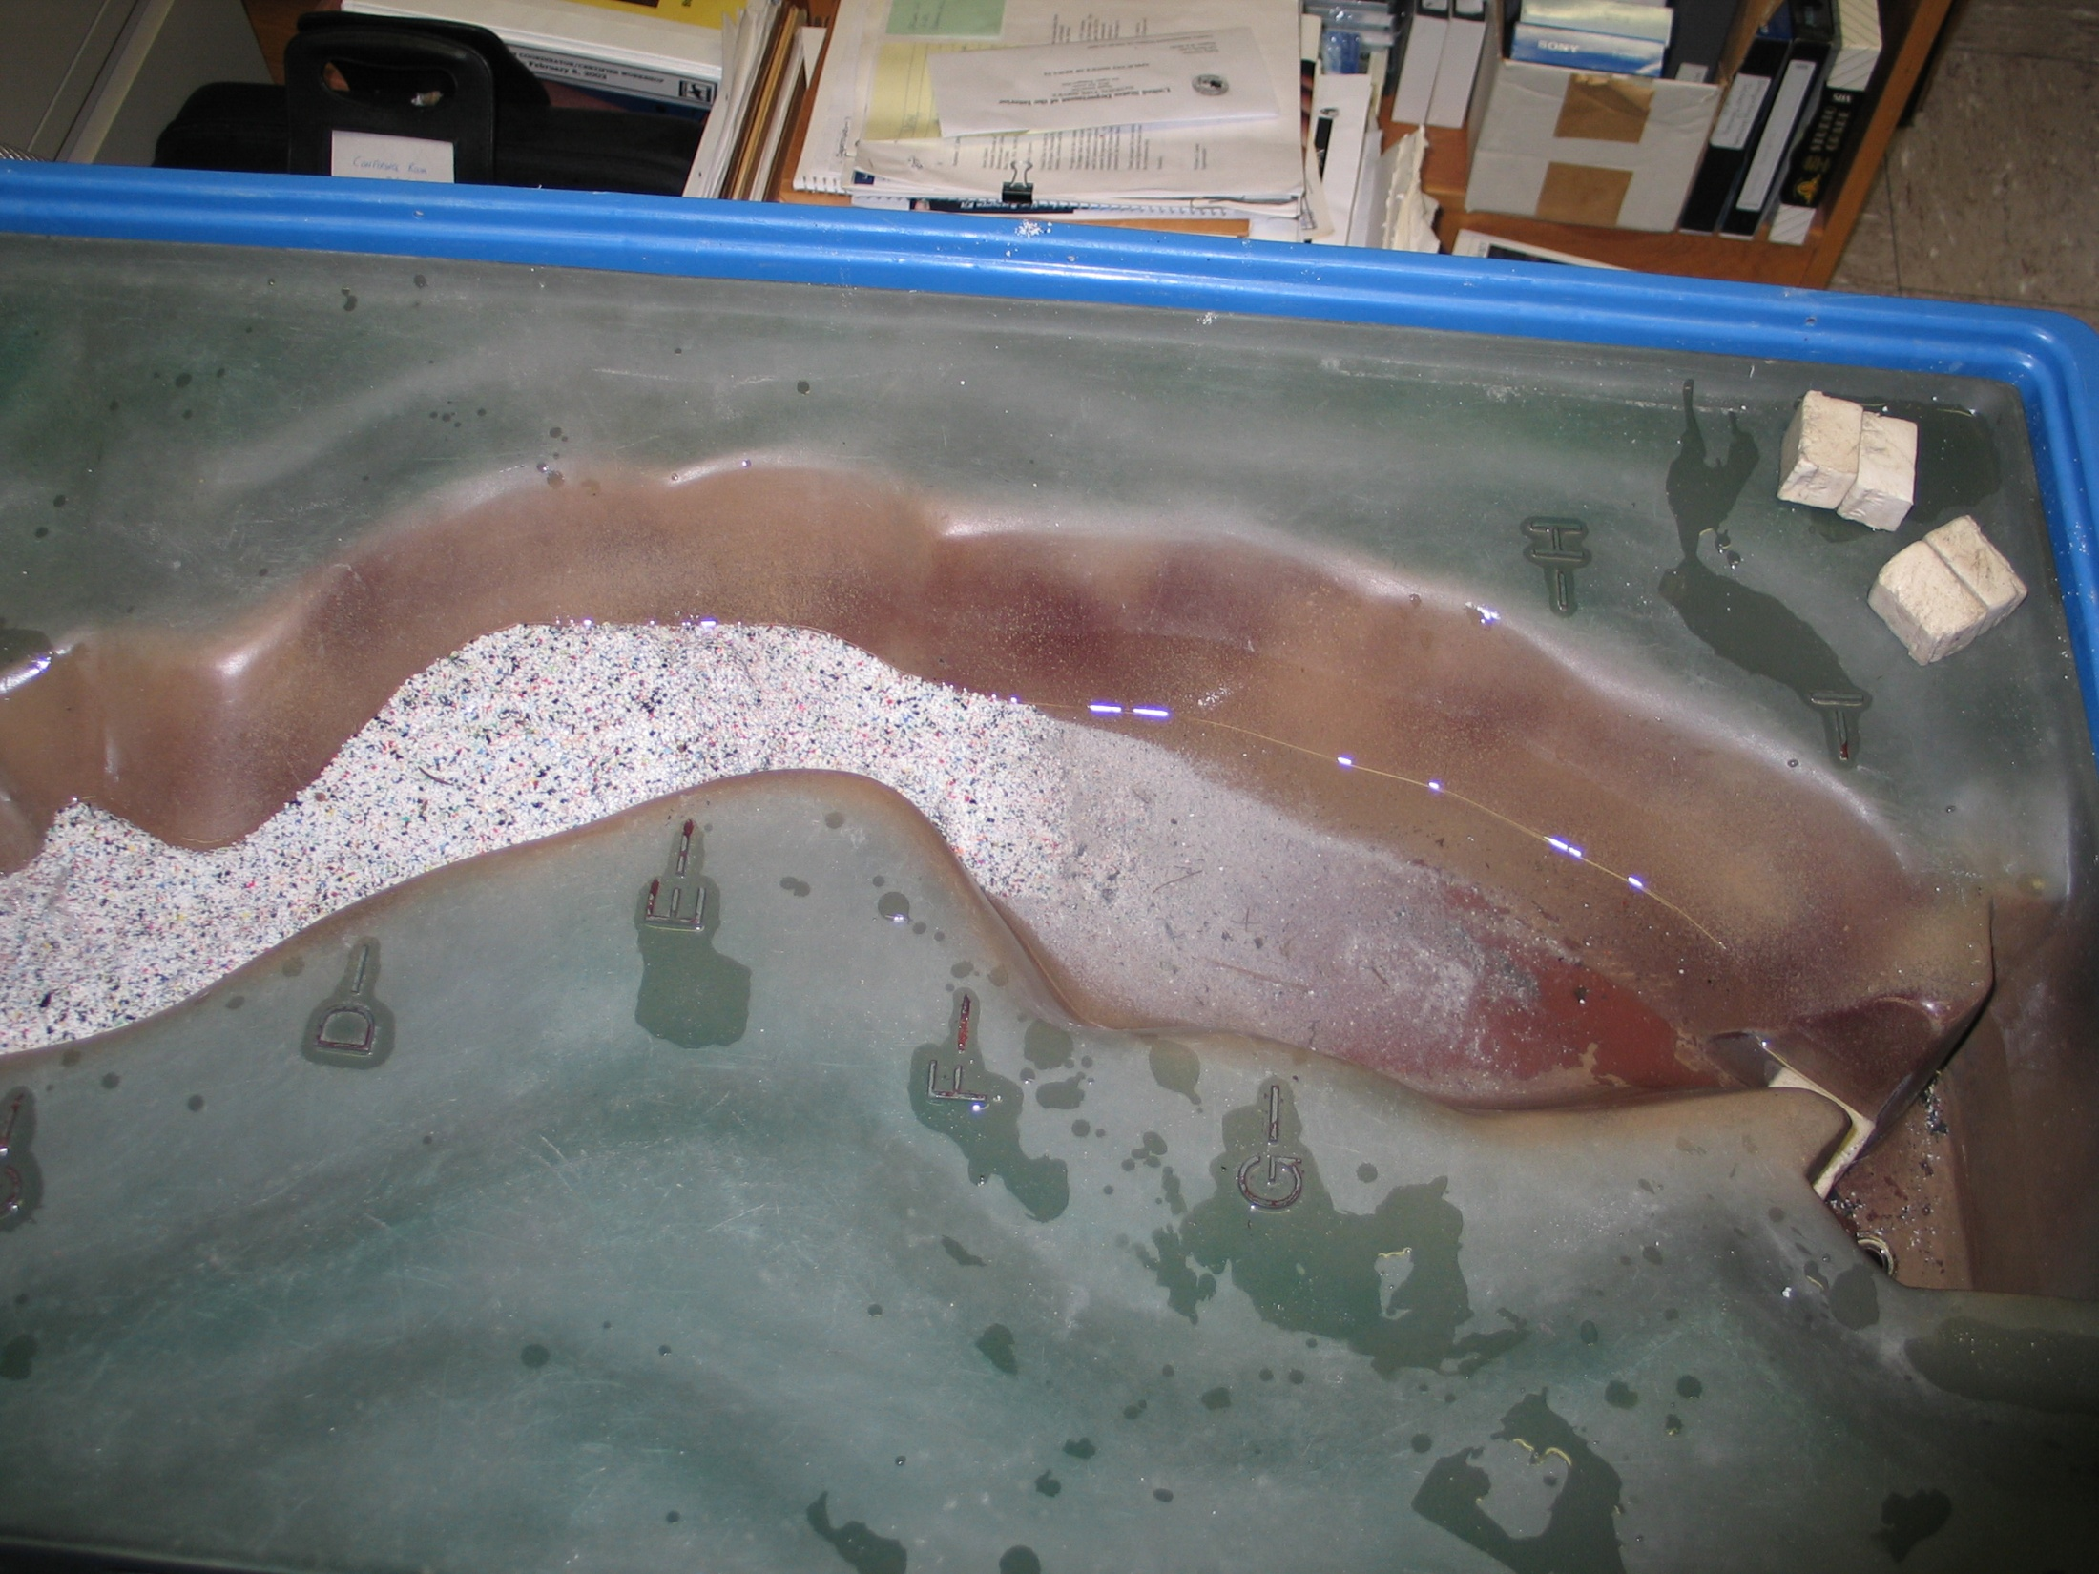

It Will Take Many Years for Vegetation to Reclaim
the Former Lake Bed

Slide 8
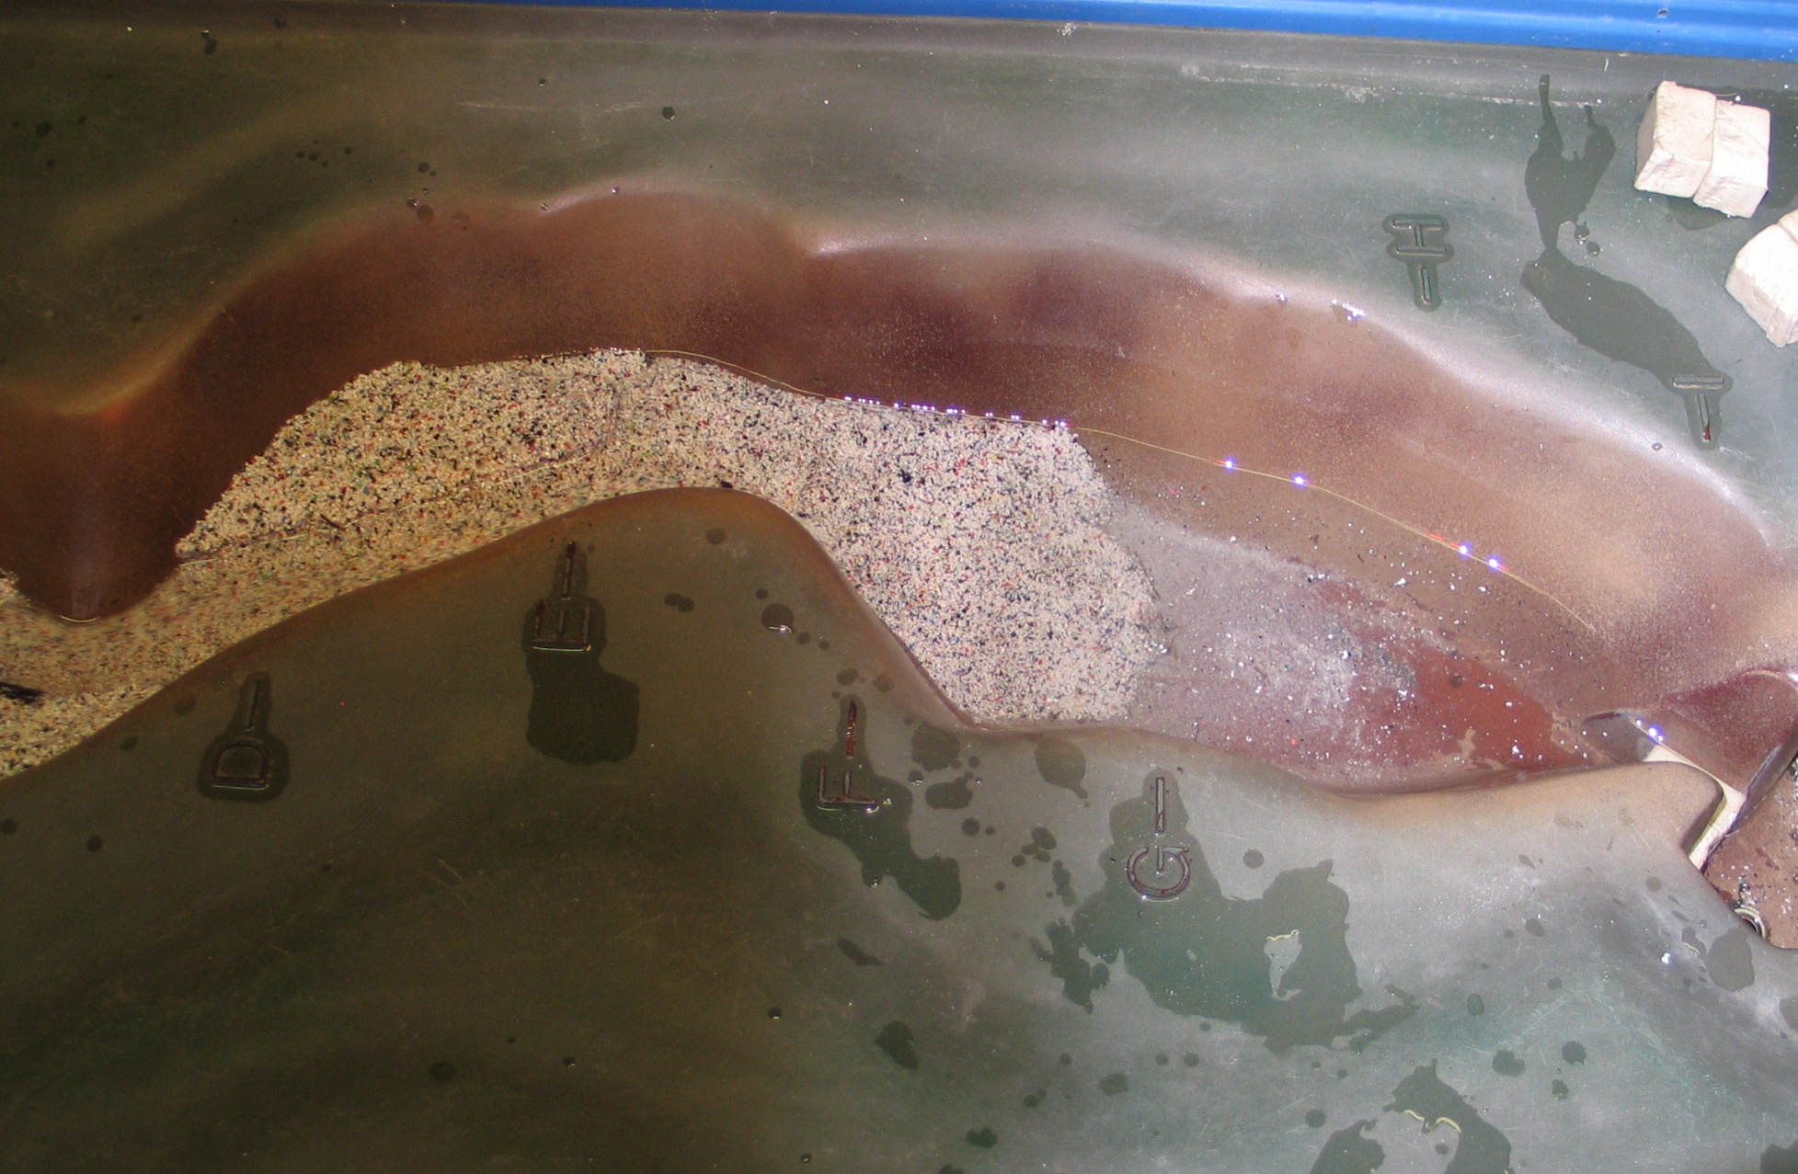

Slide 9
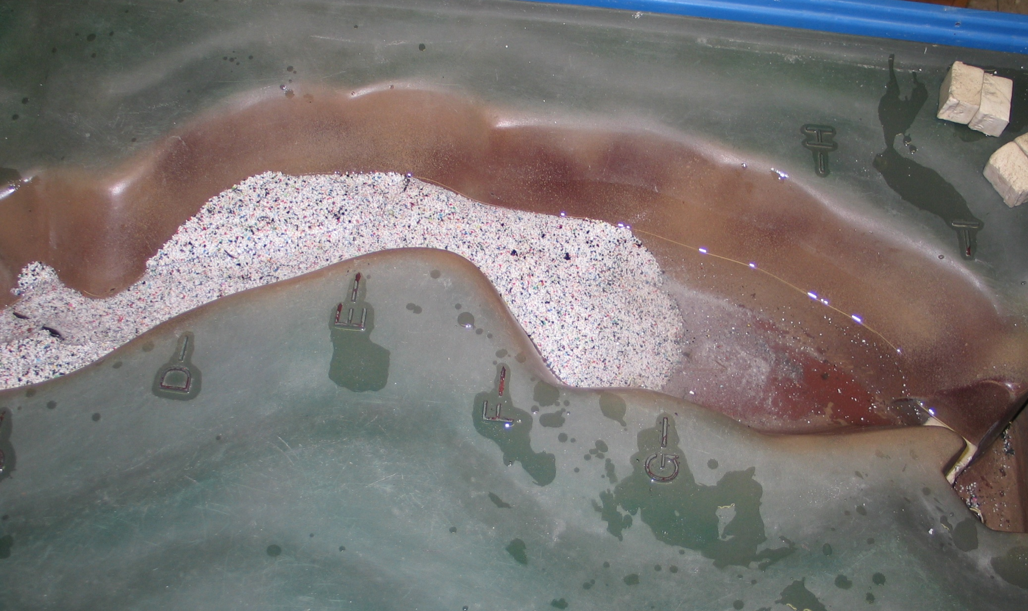
When the Last Segment of the Dam is Removed
Watch How the Delta Moves Downstream

Slide 10
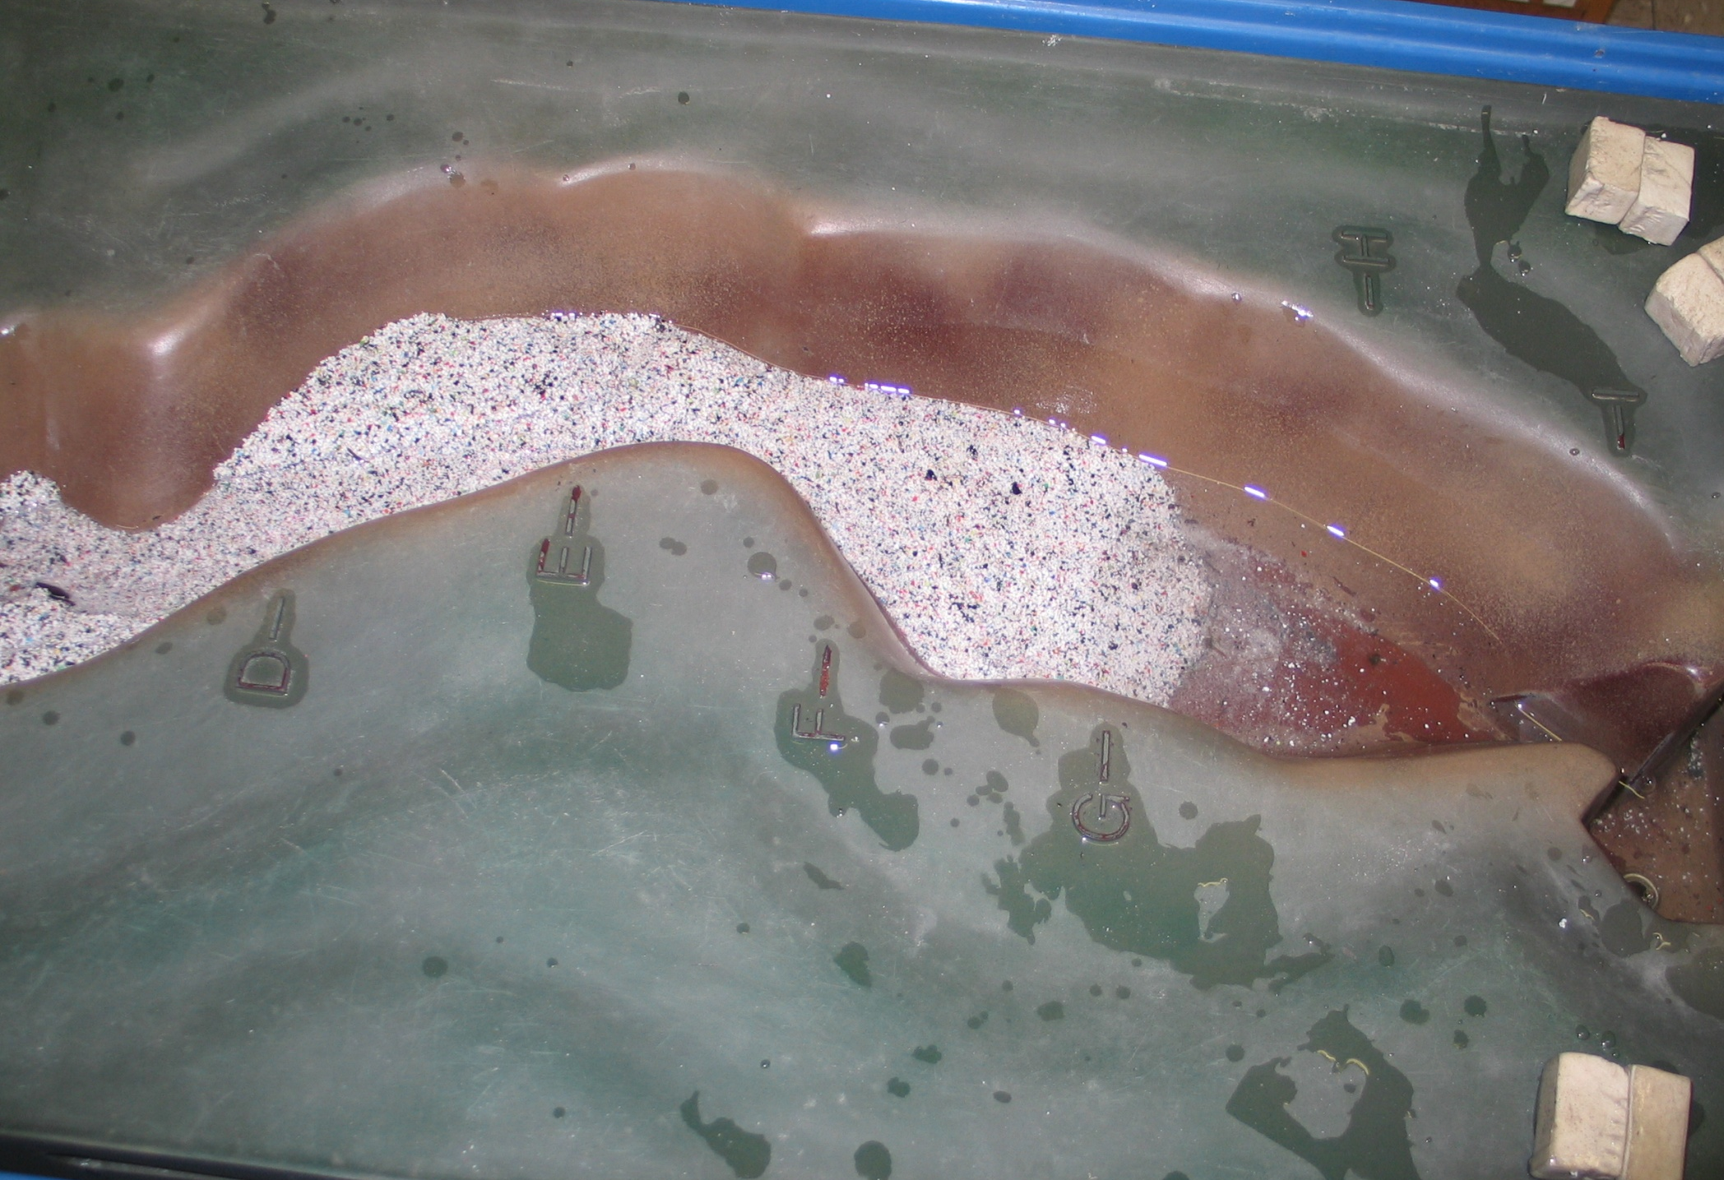
The Black Line Represents Where the Lake Level

Slide 11
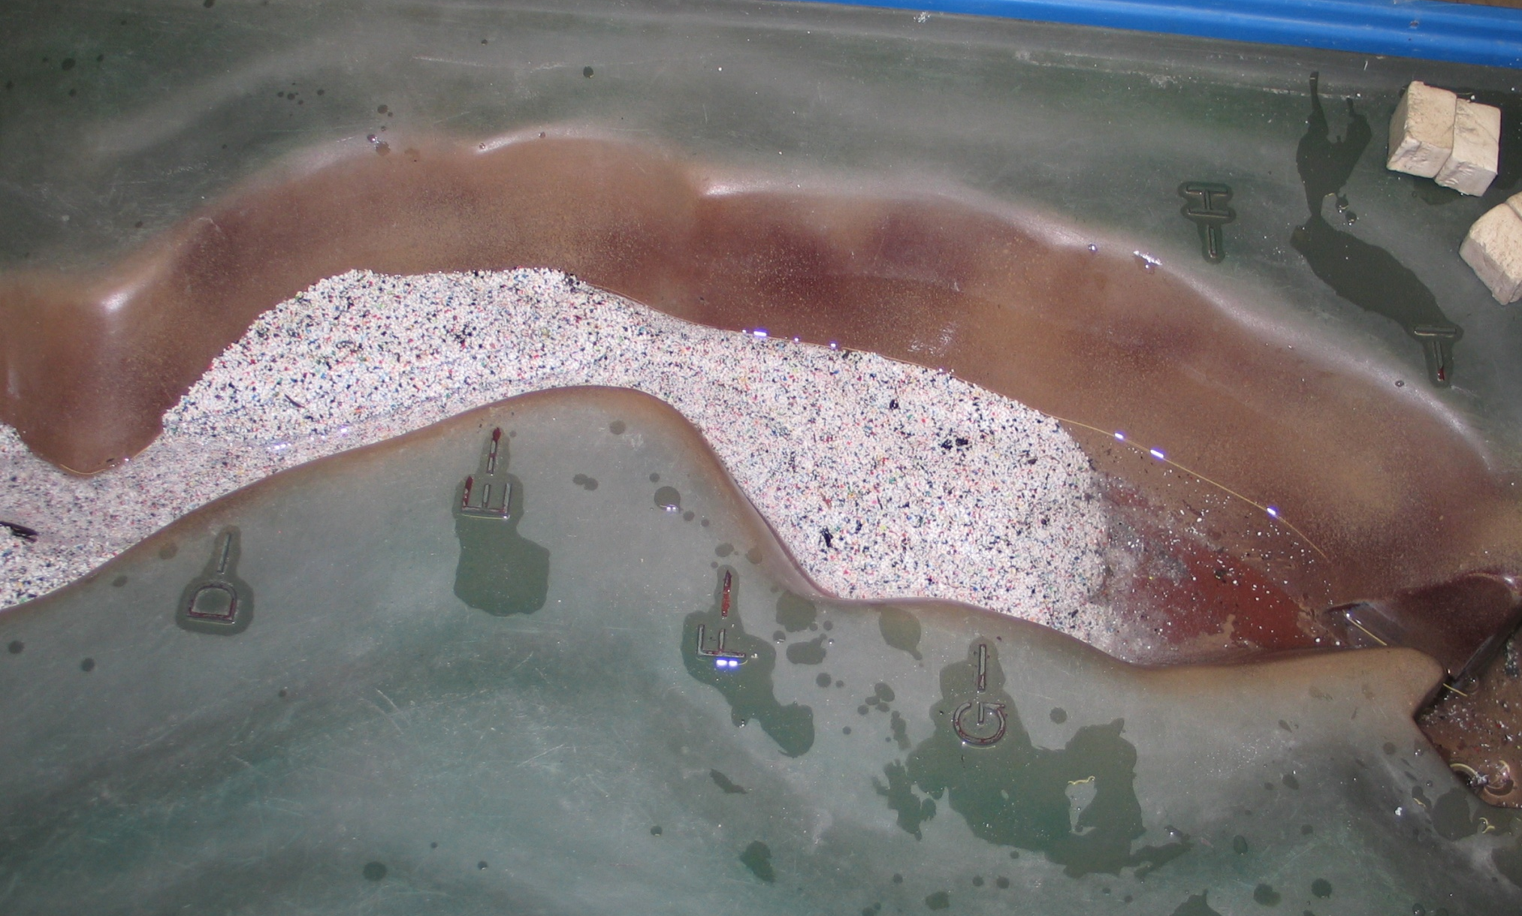
Notice the Braiding of the River Near the Advancing Delta

Slide 12
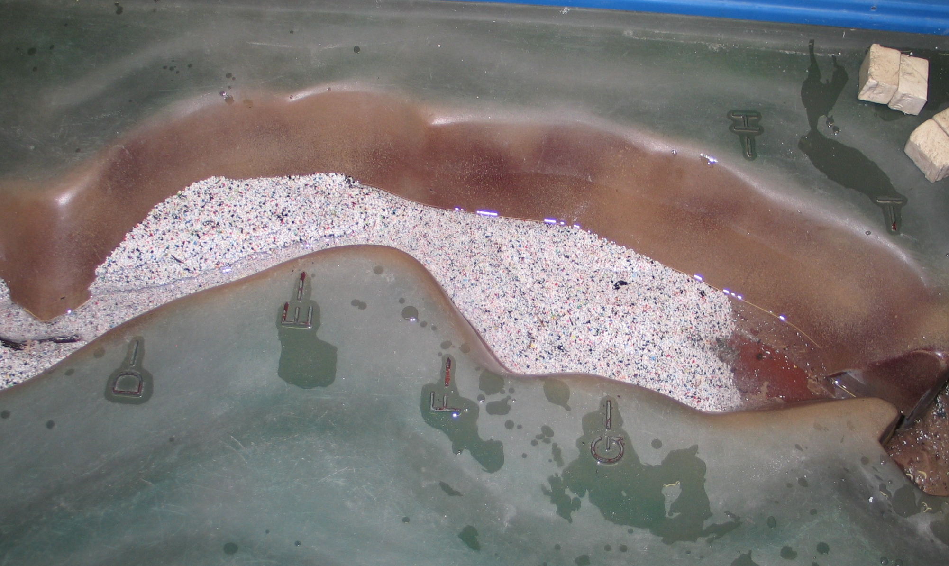
As the River Incises into the Former Delta
A Terrace Begins to Form

Slide 13
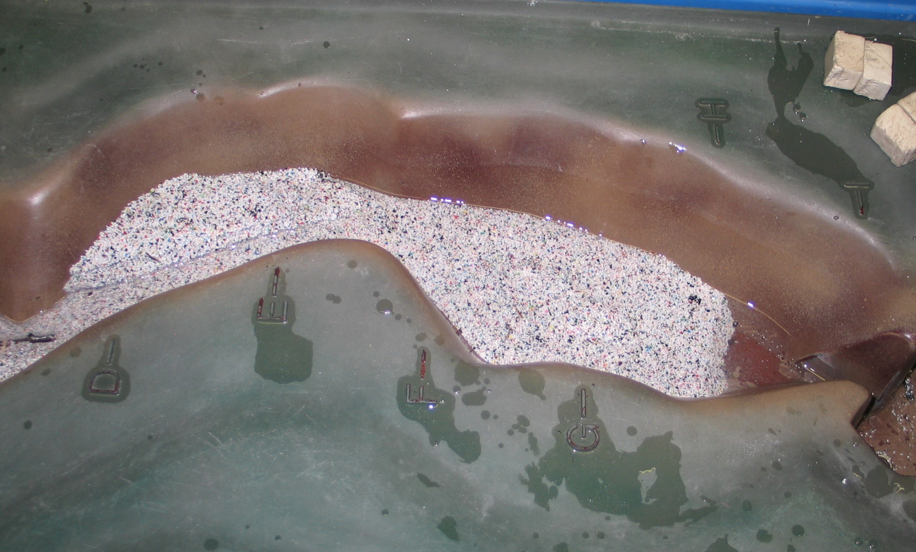
The Lower the Lake Level, the Steeper the Gradient
Which Increases Velocity and the Erosive Power of the River

Slide 14
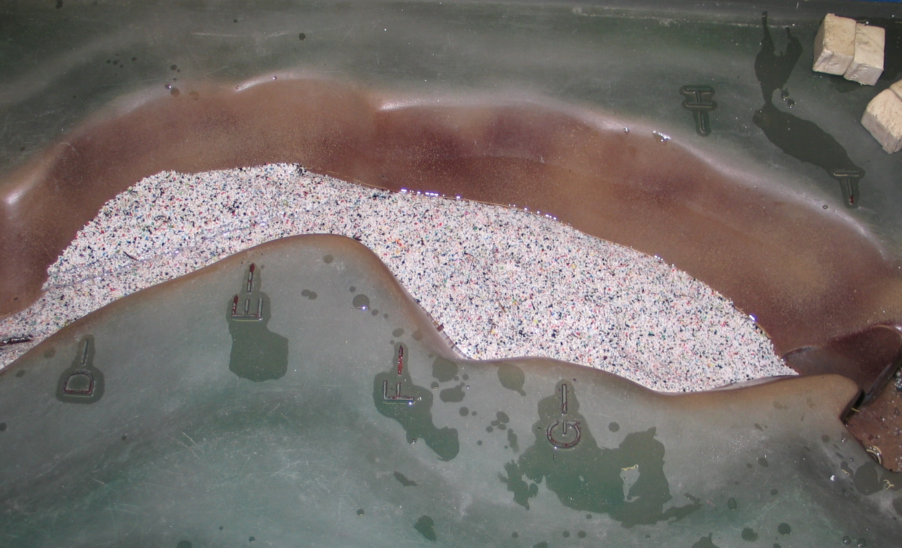
As the River Reaches the Bedrock
It Deposits Sediment Across the Former Lake Bottom

Slide 15
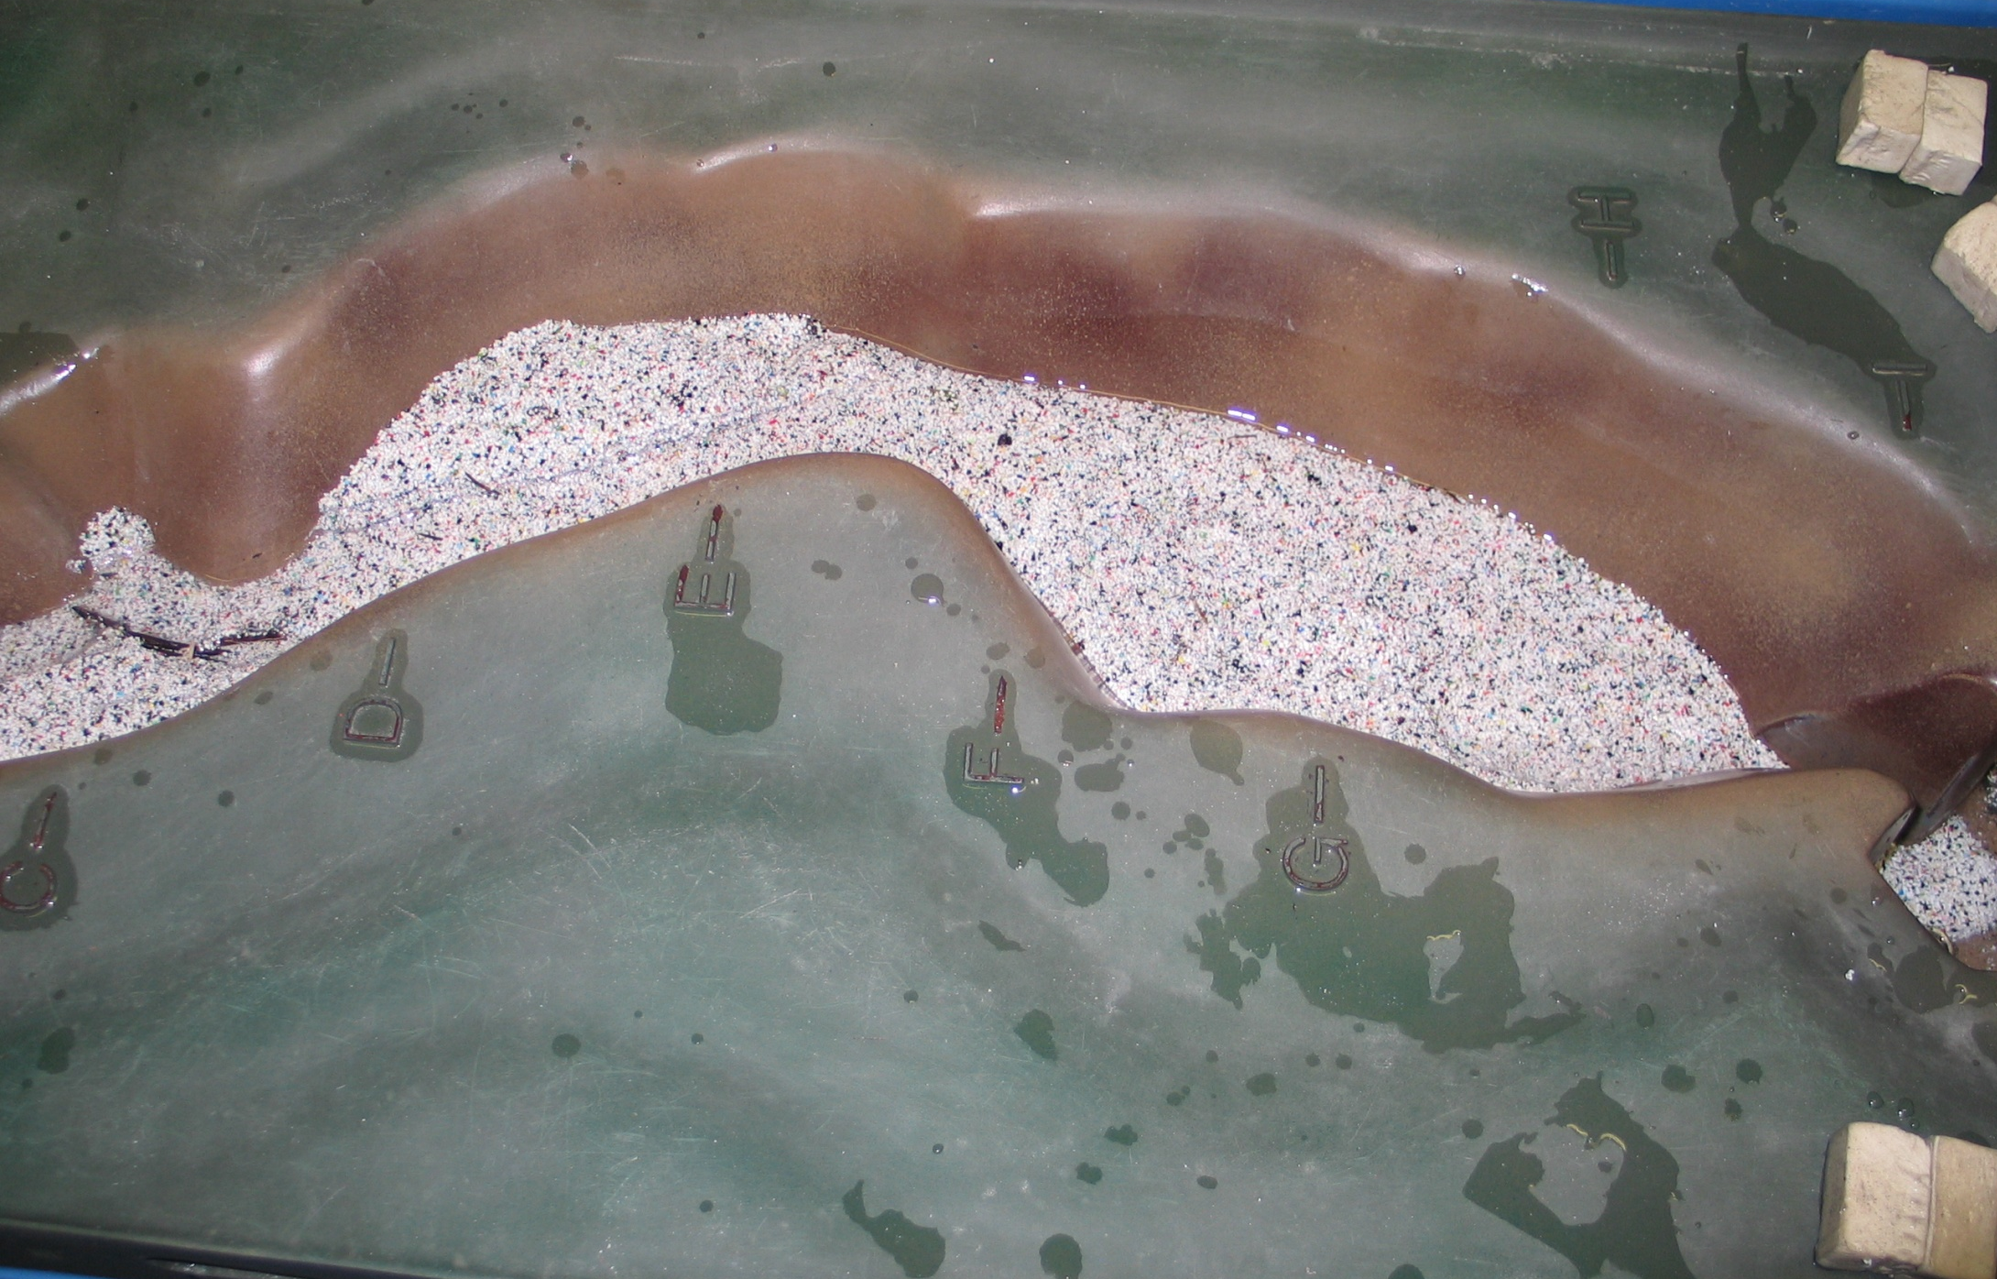
This Decreases the Velocity and Causes the River to Braid

Slide 16
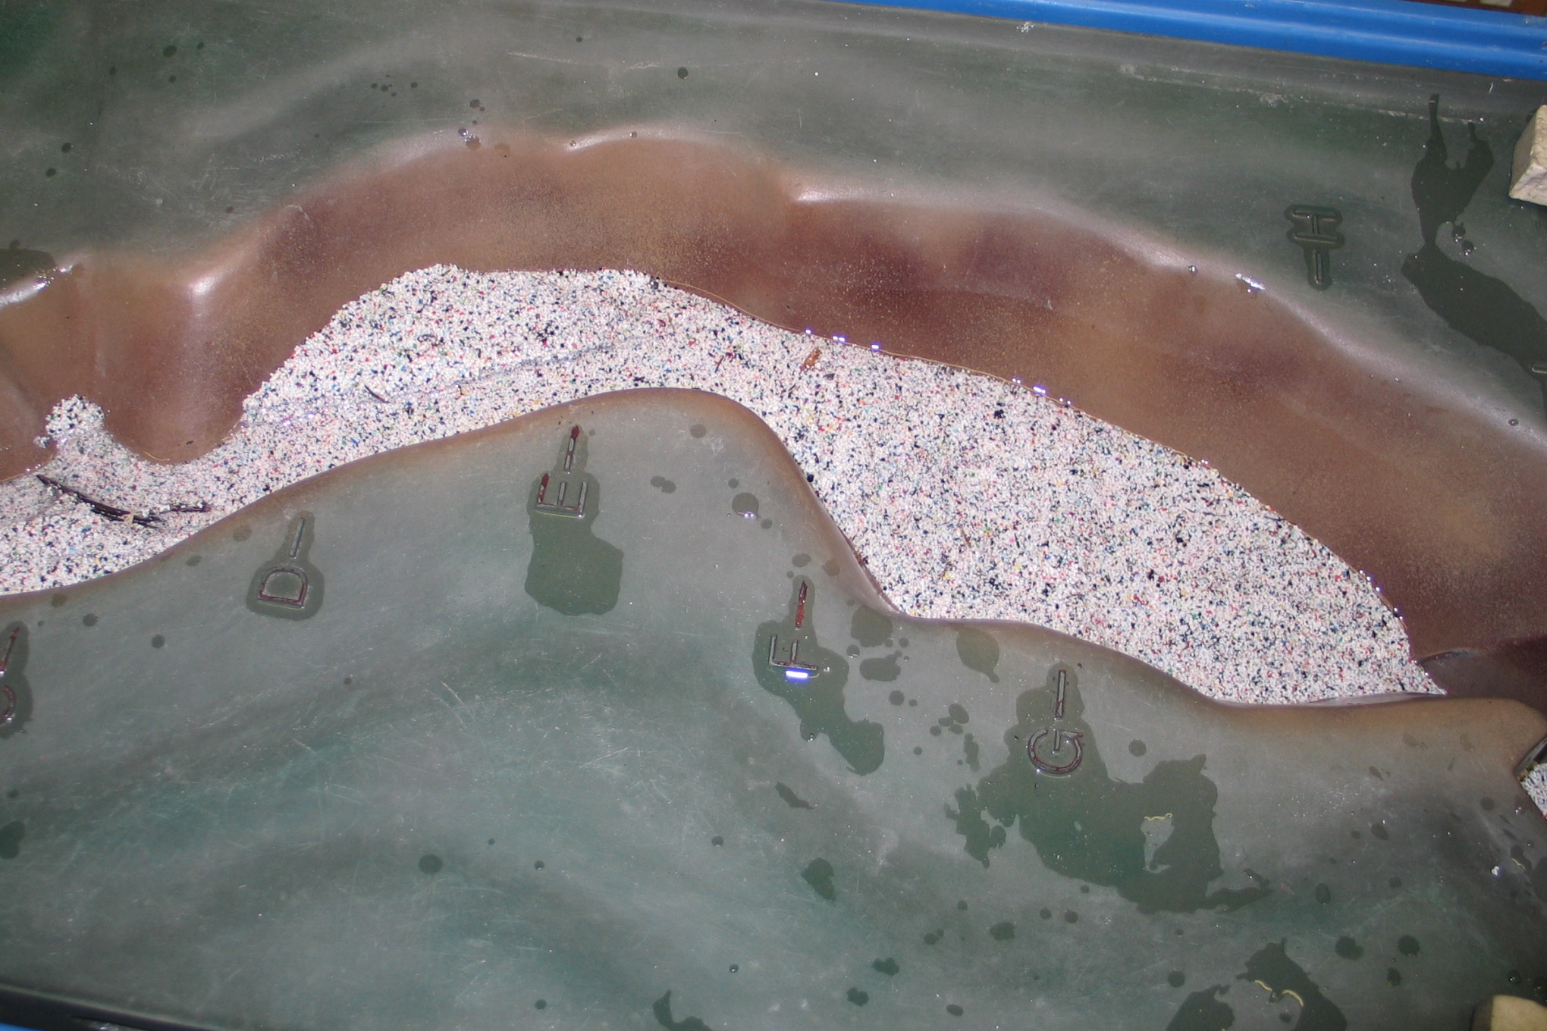
Notice the Meanders as it Strikes Sediment Mounds

Slide 17
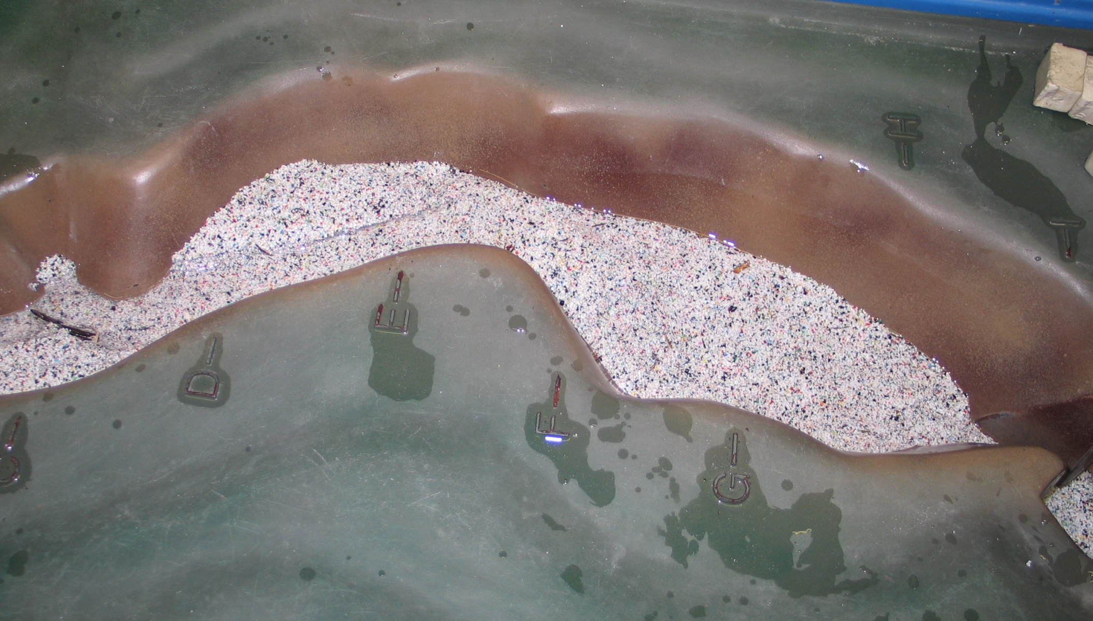
However, Changing River Flow Levels Cause
The River Course to Change Constantly

Slide 18
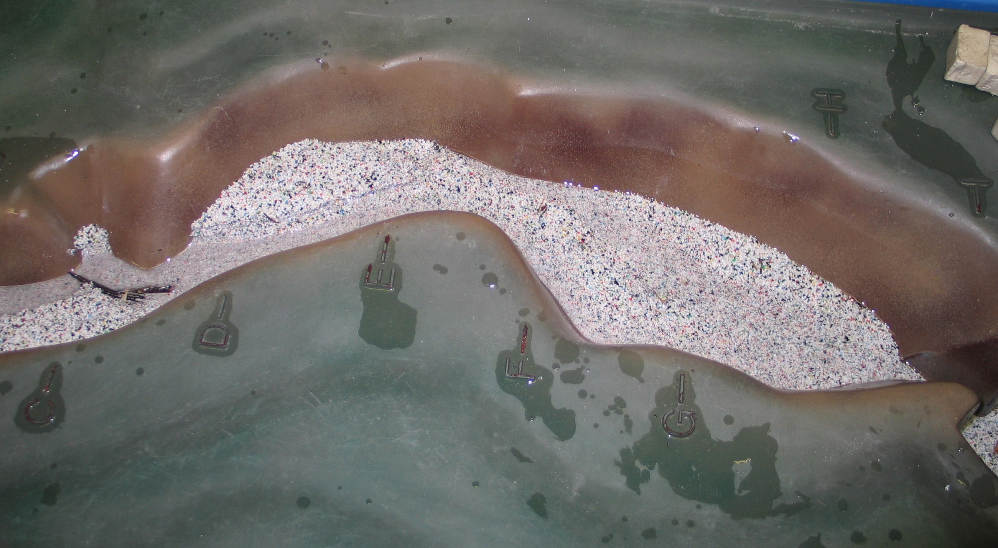
During High Springtime Flows
The River Can Occupy Much of the Flood Plain

Slide 19
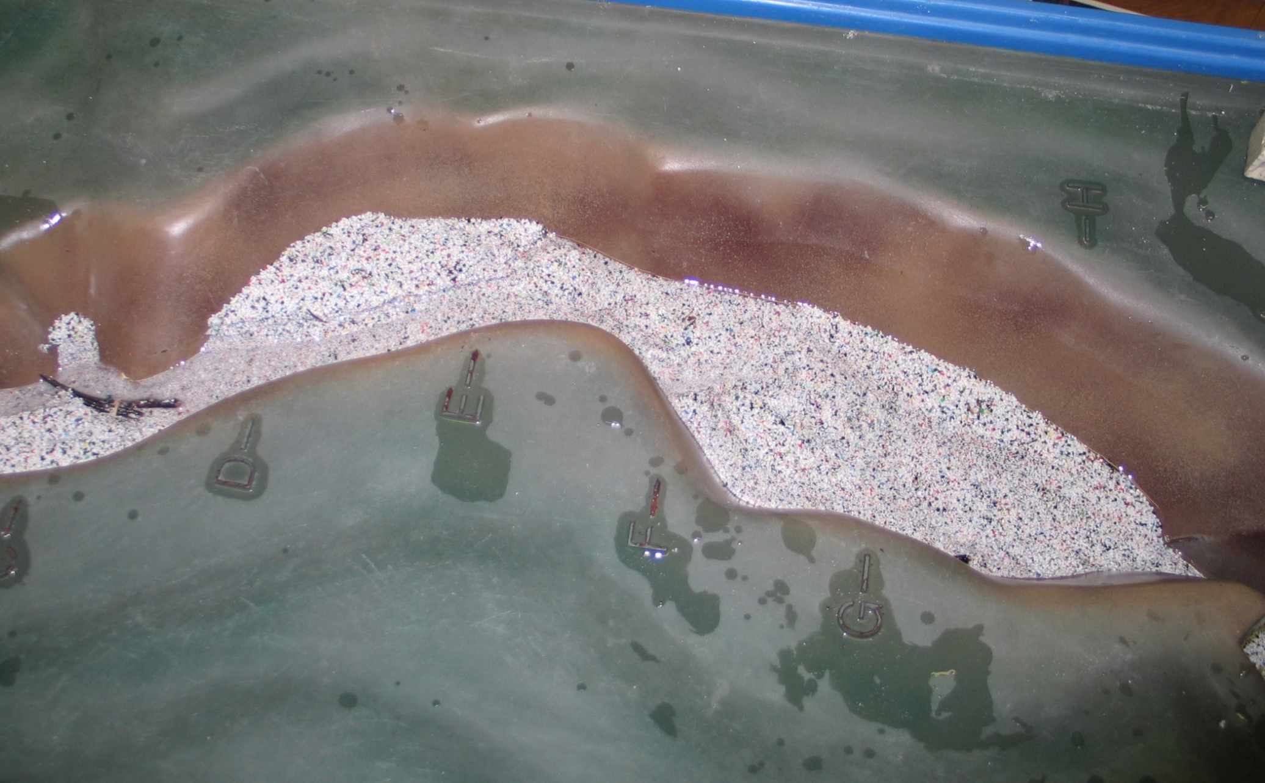

As Conditions Dry Out in Summer
More Gravel Bars Start to Appear

Slide 20
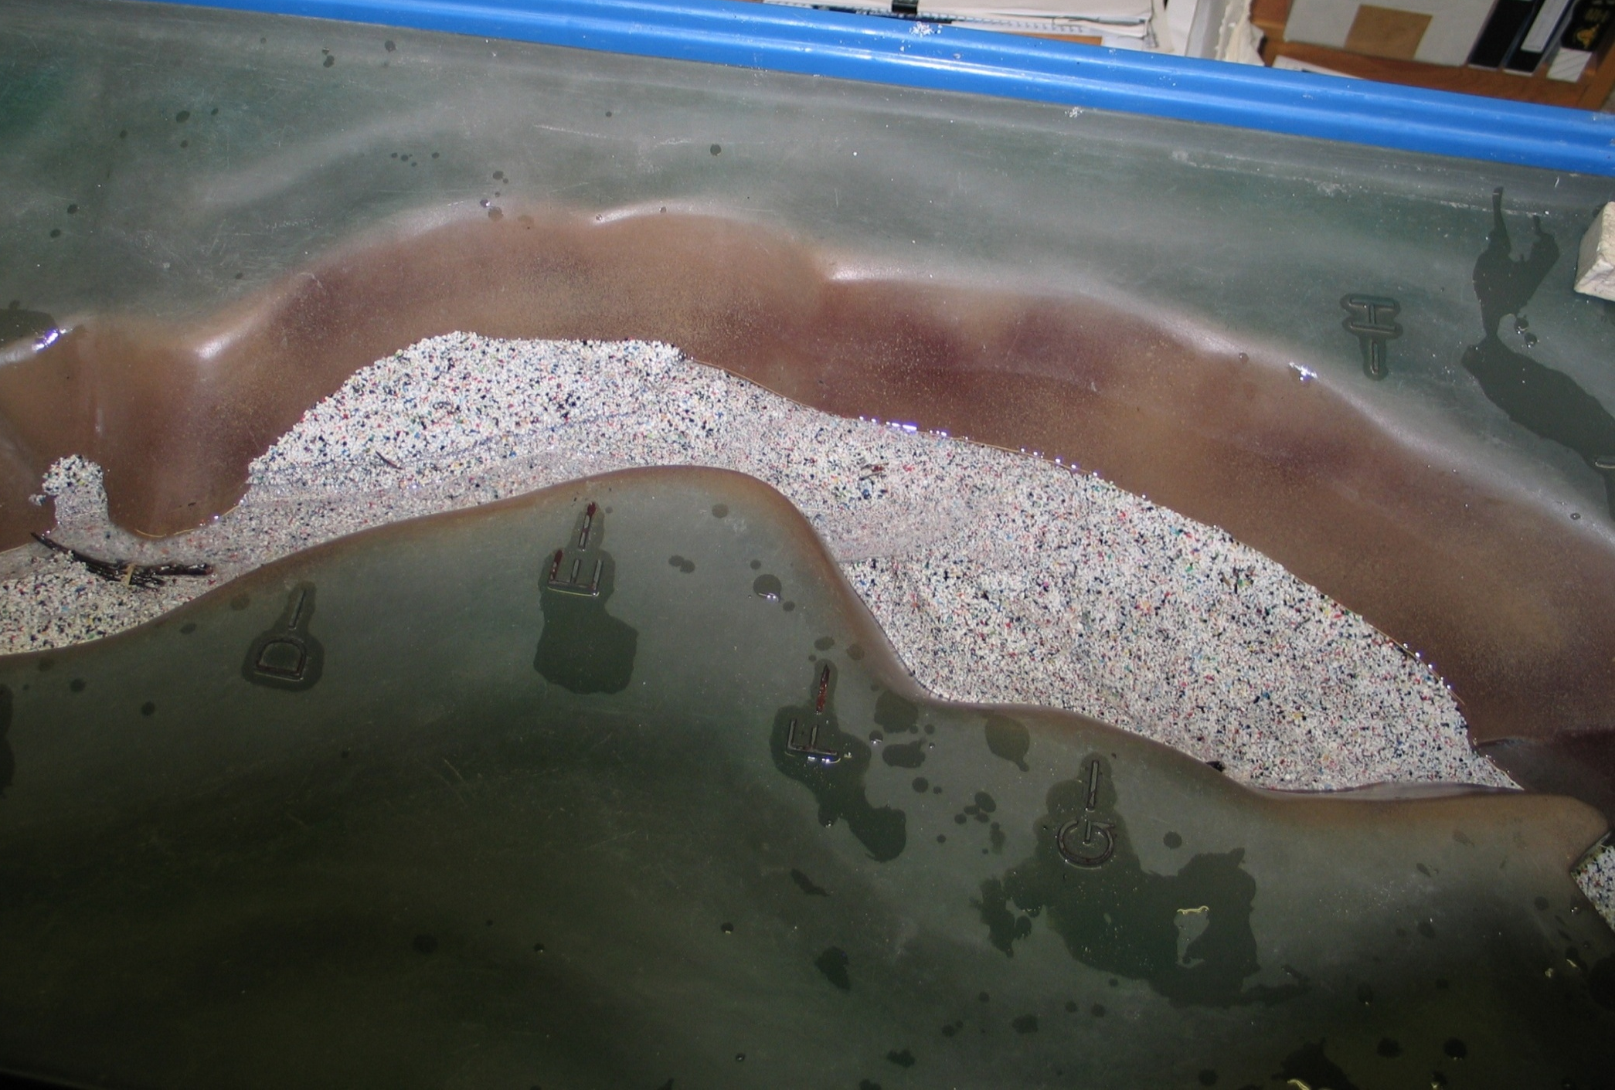
Terrace
Gravel Bar

Slide 21
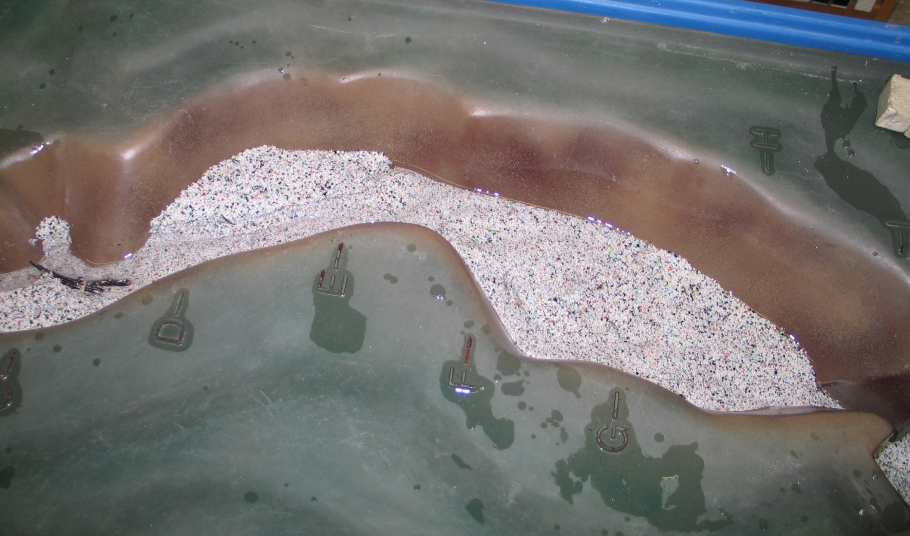
Through this Sequence of Images Notice How
the Logjam has Diverted the River and Protected the Bank

Slide 22
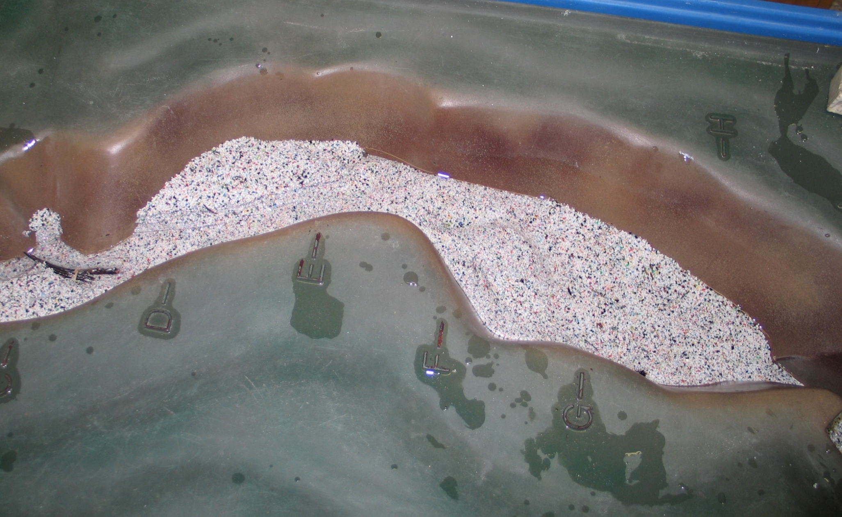
During Periods of Low Summer Flow
The River Abandons the Former Channels

Slide 23

This project was made possible in part by a grant from
Washington’s National Park Fund.

